Slide 1
TrustLedger
sealed · verified
// DELOITTE CAPSTONE 2026
TrustLedger
Enterprise AI Decision Audit & Trust Layer
The agent decides. TrustLedger records and verifies.
Presented by: Team Diet Coke
Team Diet Coke · Manipal University Jaipur

Slide 2
01 · PROBLEM
AI decides in seconds. Audits take days.
BLACK BOX
COMPLIANCE DEBT
High-stakes AI decisions ship with no record of the evidence or reasoning behind them.
Audit teams reconstruct what happened from chat logs, prompts and guesswork.
NO DEFENSIBILITY
SCALE
When a decision is challenged, teams can’t show why it was made - or prove it hasn’t changed.
Every new AI agent multiplies the exposure. The firm needs one trust layer across all of them.
DECIDE minutes → AUDIT days → WITH TRUSTLEDGER minutes
\
TrustLedger · Deloitte Capstone 2026
02 / 15

Slide 3
02 · BACKGROUND
Enterprises are delegating decisions to AI - fast
ADOPTION
consulting, banking, insurance now run AI on live decisions
credit, pricing, diligence - real consequences, real clients
REGULATION
EU AI Act, DPDP and RBI demand records
what was decided, on what basis, and by whom - auditable on request
TODAY'S TOOLS
observability logs telemetry, not reasoning
dashboards show latency and tokens - nothing captures the decision itself
THE PRICE
a challenged decision costs days of reconstruction
if the context can be reconstructed at all
TrustLedger · Deloitte Capstone 2026
03 / 15

Slide 4
03 · RESEARCH GAP
What’s missing: a record of the decision itself
NO STANDARD RECORD
NO TIMING
NO IDENTITY
telemetry ≠ reasoning
audits are post-hoc
logs lack who acted
no standardized, tamper-evident capture of why an AI decided what it decided
context is gone by the time anyone looks - reconstruction, not observation
without per-actor audit identity, a log is not evidence
So we asked: can we wrap existing AI agents and capture a verifiable decision record - in real time?
This capstone builds and evaluates exactly that layer - an MVP, live and demonstrable.
TrustLedger · Deloitte Capstone 2026
04 / 15

Slide 5
04 · RESEARCH OBJECTIVE
What we set out to build
O1
CAPTURE
standard, machine-readable decision records
captured while the decision happens - not reconstructed after
O2
PROTECT
tamper-evident sealing
every record hash-chained; any post-seal edit is visible
O3
PROVE
verification and replay in minutes
audit teams self-serve - no engineering required
Success = a sealed decision record you can defend in a meeting, minutes after the fact.
TrustLedger · Deloitte Capstone 2026
05 / 15

Slide 6
05 · METHODOLOGY
Built like a product, verified like an audit
DISCOVERY
design before code
PRD → data-driven schema → agent-based design
BUILD
incremental weekly milestones
FastAPI + Next.js, shipped on a 4-week roadmap with review gates
EVIDENCE
synthetic, realistic dataset
16 records across every status - including one deliberately tampered
VERIFY
tested and reviewed
38 automated tests · security reviews (auth fail-closed, CORS, redaction) closed before demo
TrustLedger · Deloitte Capstone 2026
06 / 15

Slide 7
06 · DATA COLLECTION
Data & tools - synthetic, safe, realistic
DATA
16 seeded records across six industries
real decision shapes, synthetic facts - no client data, privacy-safe by design
LIVE RUNS
OpenRouter · pinned gpt-4o-mini · temperature 0.4
fresh records generated on demand in 4–10 s, streamed live (SSE)
SOURCES
design docs · domain methodology DEL-RM-2026 · RBI circulars
scenario inputs reflect real consulting decision types
TOOLS
PostgreSQL / SQLite · SHA-256 chain · Docker · API-key auth
the full stack ships as one docker-compose
TrustLedger · Deloitte Capstone 2026
07 / 15

Slide 8
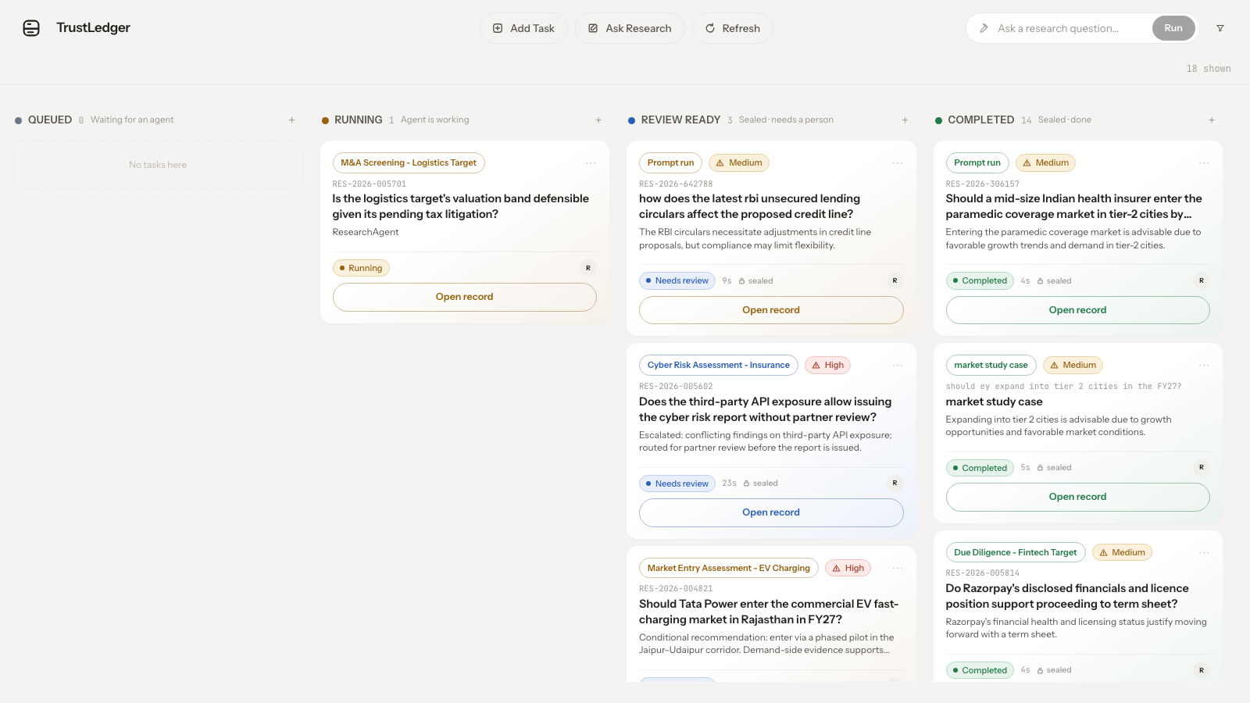
07 · FINDING 1
Capture at decision time closes the audit gap
Records captured DURING the decision are complete, contextual and cheap -
post-hoc reconstruction isn’t needed.
measured: board answers instantly · full runs in 10-15 seconds
multi-day investigation → two-minute lookup
Ask a research question and watch it happen - this is the live part of the talk.
the command center - every decision, its status and risk
TrustLedger · Deloitte Capstone 2026
08 / 15

Slide 9
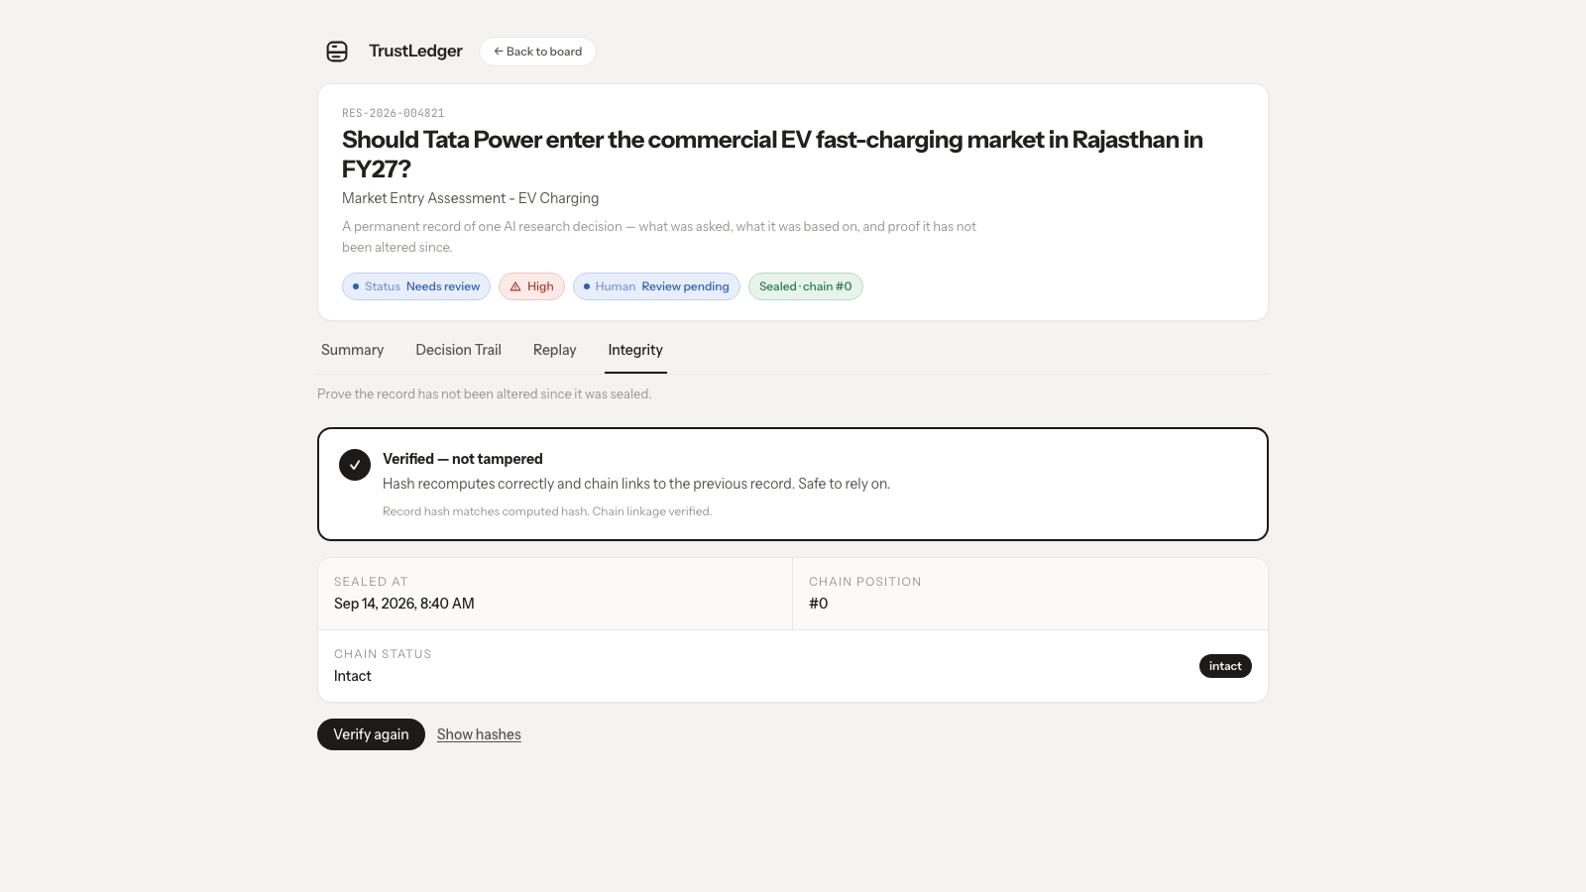
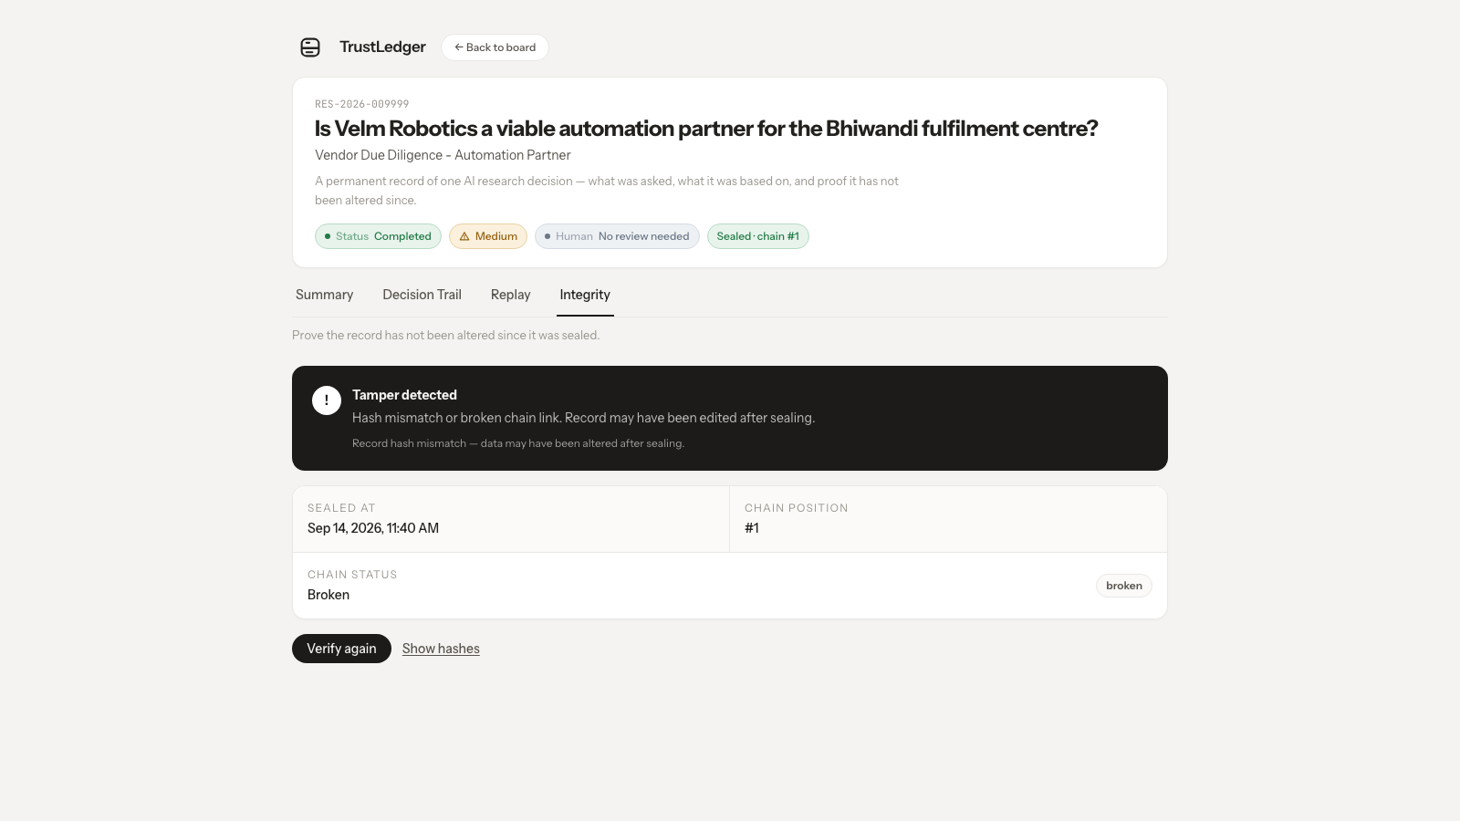
08 · FINDING 2
Tamper-evidence works - end to end
A SHA-256 chain makes any post-seal edit visible. The seeded hero verifies clean; the deliberately tampered record fails loudly.
And sealed is permanent: the API refuses edits and deletes - 409 · TASK_SEALED
side by side, from the live app:
✓ VERIFIED - hash recomputes, chain intact
! TAMPER DETECTED - record edited after sealing
TrustLedger · Deloitte Capstone 2026
09 / 15

Slide 10
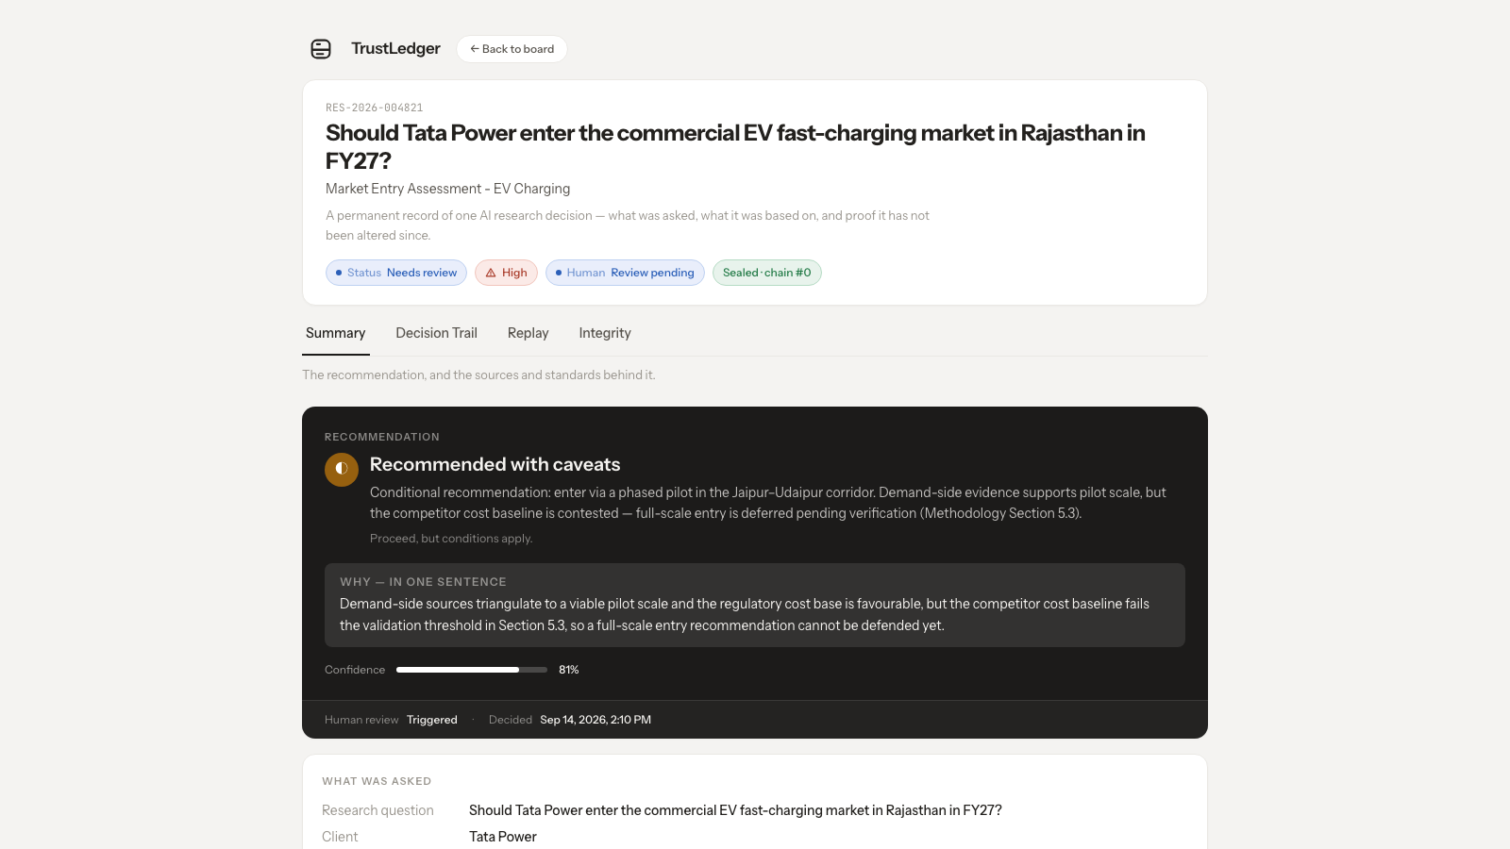
09 · FINDING 3
Trust needs identity and process, not just crypto
WHO ACTED
every event carries the actor’s audit identity
per-principal API keys - the trail records who did what
PROCESS
high-risk decisions route to a human
review triggers before sealing - risk-ranked, not one-size
RELIABILITY
a run survives the browser closing
background task + wall-clock budget - no stranded records
the sealed record - Summary · Decision Trail · Replay · Integrity
TrustLedger · Deloitte Capstone 2026
10 / 15

Slide 11
10 · IMPLICATIONS
What this means for the firm
FASTER AUDITS
DEFENSIBLE AI
two-minute lookups instead of multi-day reconstructions
decisions you can show, replay and defend in a meeting
COMPLIANCE READINESS
TRUST AS AN ASSET
records that satisfy EU AI Act · DPDP · RBI expectations
the firm that can prove its AI is the one clients trust
sold to the people who sign off: risk officers · compliance teams · audit committees
TrustLedger · Deloitte Capstone 2026
11 / 15

Slide 12
11 · LIMITATIONS
What we know we haven’t solved - yet
TAMPER-EVIDENT ≠ PROOF
the hash chain is unkeyed
anyone with DB write access could recompute the chain - HMAC keying is designed
ASSERTED SOURCES
cited sources come from the model, not retrieval
no fetch, no verification that a cited document exists - retrieval is next
NON-DETERMINISM
the same question can return different outcomes
temperature pinned at 0.4 - consistency across runs remains open
VERIFY-ON-READ
GET /decisions serves snapshots before verifying
a tampered record still reads clean on Summary - our top open item
TrustLedger · Deloitte Capstone 2026
12 / 15

Slide 13
12 · FUTURE RESEARCH
Where this goes next
TAMPER-PROOF
keyed HMAC chain - tamper-proof, not just tamper-evident · verify-on-read on every fetch
ACCESS CONTROL
RBAC with row-scoped roles · encryption at rest
GROUNDING
retrieval-verified citations - sources that really exist, fetched and checked
SCALE
more agent integrations · multi-model routing with pinned models
PRODUCT
compliance dashboards · exportable audit packs for regulators
TrustLedger · Deloitte Capstone 2026
13 / 15

Slide 14
// THE TAKEAWAY
The agent decides.
TrustLedger records and verifies.
RESEARCH
EVIDENCE
REASONING
HUMAN REVIEW
VERIFIED DECISION
AI decisions, auditable in minutes - tamper-evident by design.
Team Diet Coke · Manipal University Jaipur

Slide 15


Q&A
thank you
Github: ApexYash11/TrustLedger
Loom - Live Demo
Team Diet Coke · Deloitte Capstone 2026 · Manipal University Jaipur
The agent decides. TrustLedger records and verifies.

